Slide 1
Anomaly Detection in Smart Buildings using Federated Learning
Tuhin Sharma | Binaize Labs
Bargava Subramanian | Binaize Labs

Slide 2
Outline
What is Smart Building?
Anomalies in Smart Building.
Challenges in IoT.
Federated Learning.
Anomaly detection using Federated Learning
Demo
Types of Federated Learning.
Pros and Cons.
Notes:
Today we shall discuss how IoT devices are controlling our day to day life, the challenges of anomalies in the smart building and how we can solve the problem with a different genre of machine learning called federated learning.

Slide 3
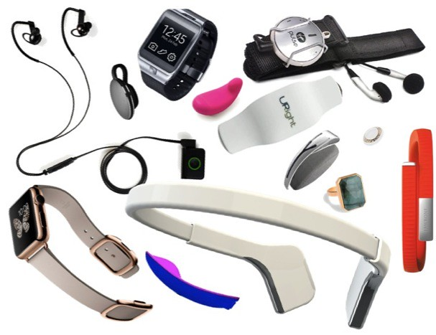
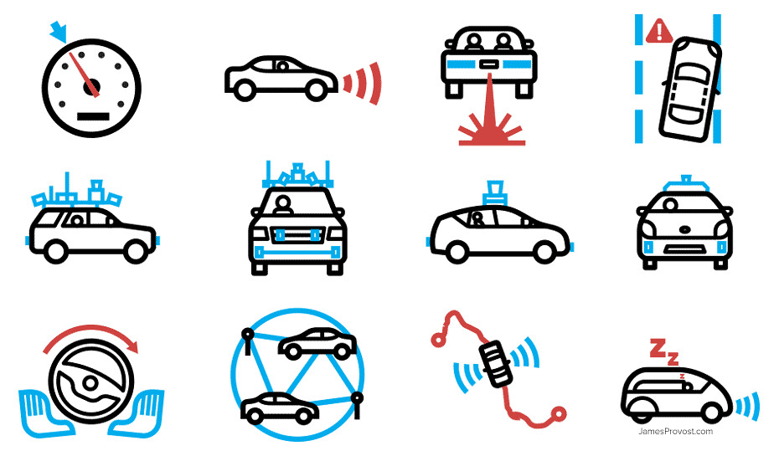
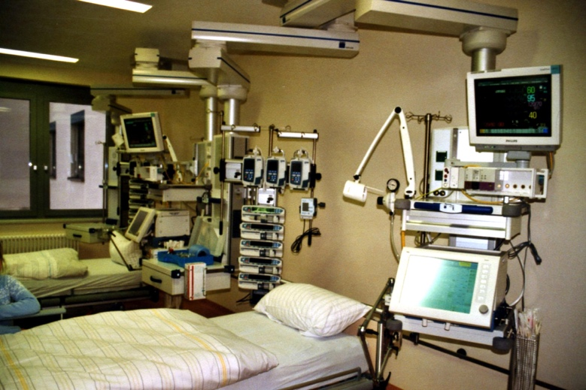



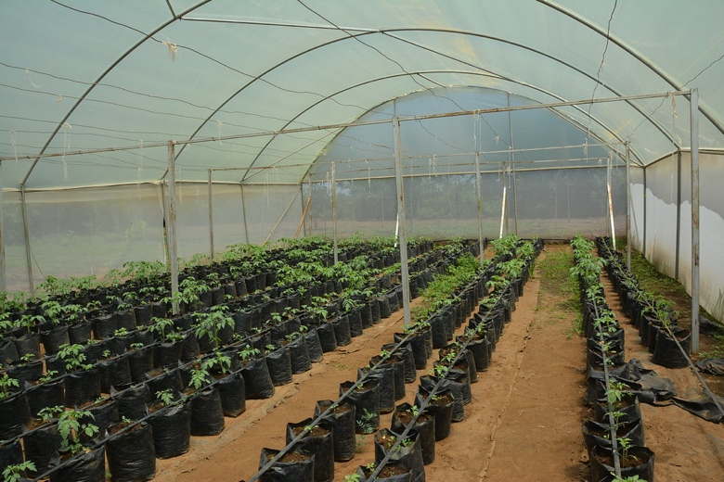
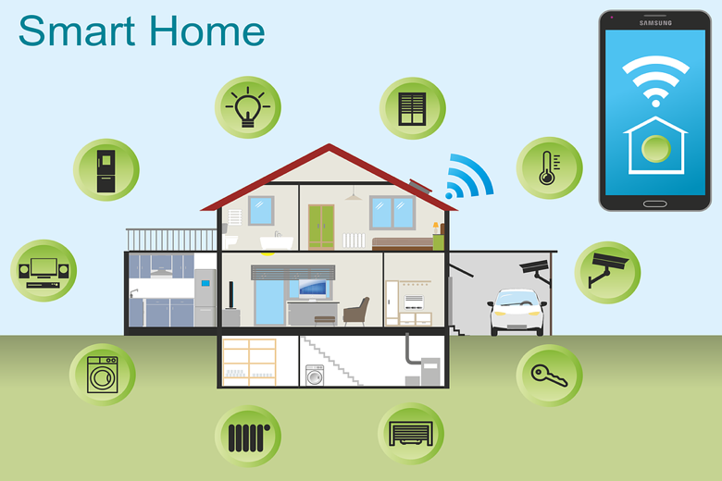

We are increasingly moving towards a smart inter-connected world
Wearables
Self-driving cars
Healthcare
Drone
Smart Retail Store.
Industrial IoT
Smart Farm
Smart Home and Building
Smart City
10B+ IoT devices!!
Notes:
We cannot think about a world without IoT.
Our life is influenced and controlled by the vastness of IoT devices.

Slide 4

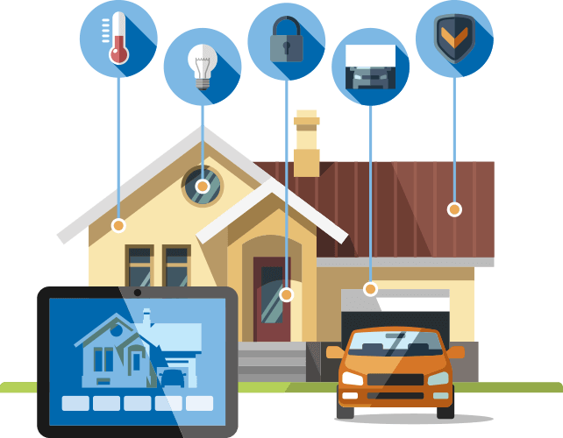
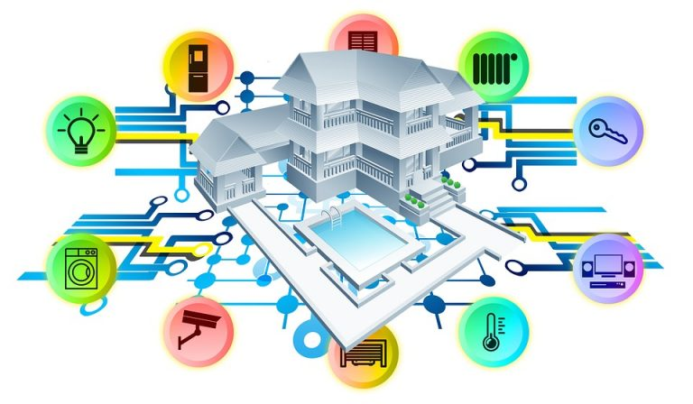
What is Smart Building?
Smart buildings not only take complete care of tenants’ comfort and safety but also promote energy and financial savings. Now, AI also contributes to making buildings smarter and more intelligent than ever.
- Forbes 2019
ARTIFICIAL INTELLIGENCE
SMART BUILDING
SMARTER BUILDING
Notes:
Smart buildings has been a buzzword for quite some time now. However, what’s it all about? Well, there isn’t any universally accepted definition that we can refer to.
Modern buildings are more than just four walls and a roof. In fact, building walls now even have ears and eyes.
With pervasive wireless connectivity, buildings today generate tons of data that can be used to improve efficiency and sustainability. AI and smart buildings are an ideal combination to streamline and optimize the functioning of buildings.
In short, AI is making smart buildings even smarter.
https://www.forbes.com/sites/cognitiveworld/2019/08/13/how-ai-is-making-buildings-smart-and-intelligent/#58abe56628d7

Slide 5
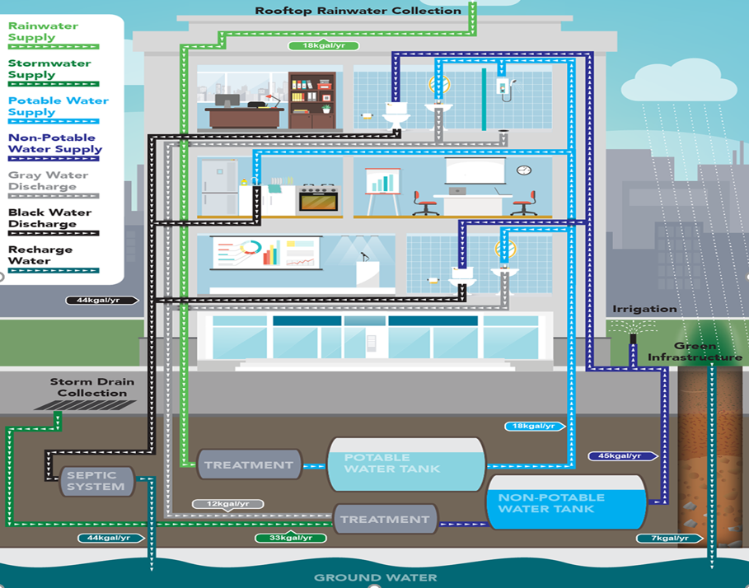

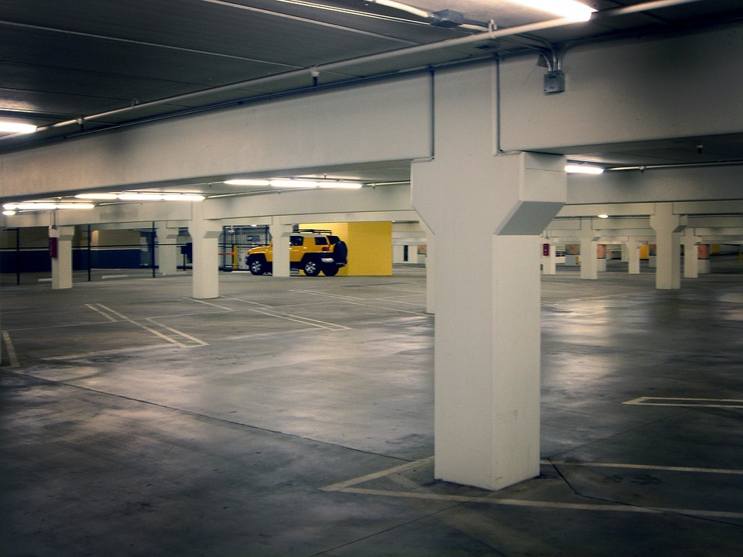




How AI is helping buildings become smarter
WATER MANAGEMENT
BUILDING MAINTENANCE
PARKING ASSISTANCE
SMART BULBS MANAGEMENT
HVAC MANAGEMENT
Notes:
Water management - We spend 90 percent of our time indoors. Imagine the amount of water that we consume on a daily basis for different purposes. it is important to consider our water consumption levels and take appropriate measures to reduce it. Sensors embedded in water supply channels to toilets, bathrooms, and water tanks will give information on the standard water consumption of a single family or an office. The data from these sensors can be fed to an AI tool to check if any family or office is consuming more water than the expected levels. If yes, the tool will notify the manager and proper action can take place.
Building maintenance - Everybody wants their building spaces to be clean, well-maintained and safe. Sensors and cameras can capture the details of every corner of a building. This data, when fed to an AI tool, can notify building managers about areas to carry out on-the-spot cleaning processes.
Parking assistance - Parking is a major concern for people in today’s fast-paced world. While visiting any new place, a significant amount of time can be wasted identifying a vacant parking space. pressure sensors in the ground and cameras all around can gather information on parking lots. An AI parking tool, when fed with this data, will analyze the parking space utilization and give complete information on empty parking spaces.
Smart Bulbs - In the case of large organizations or buildings, monitoring and controlling every light bulb isn’t as easy as we think. Imagine the effort involved in manually checking and switching on or switching off hundreds (and possibly thousands) of light sources. Implementing an IoT smart bulb monitoring system can automate operational maintenance and improve performance quality.
HVAC Management -
In case of HVAC management, (Heat Ventillation Air Conditioning unit) data captured by heat sensors can be utilized by AI tool to do automatic temperature control in the building.
https://www.forbes.com/sites/cognitiveworld/2019/08/13/how-ai-is-making-buildings-smart-and-intelligent/#58abe56628d7

Slide 6
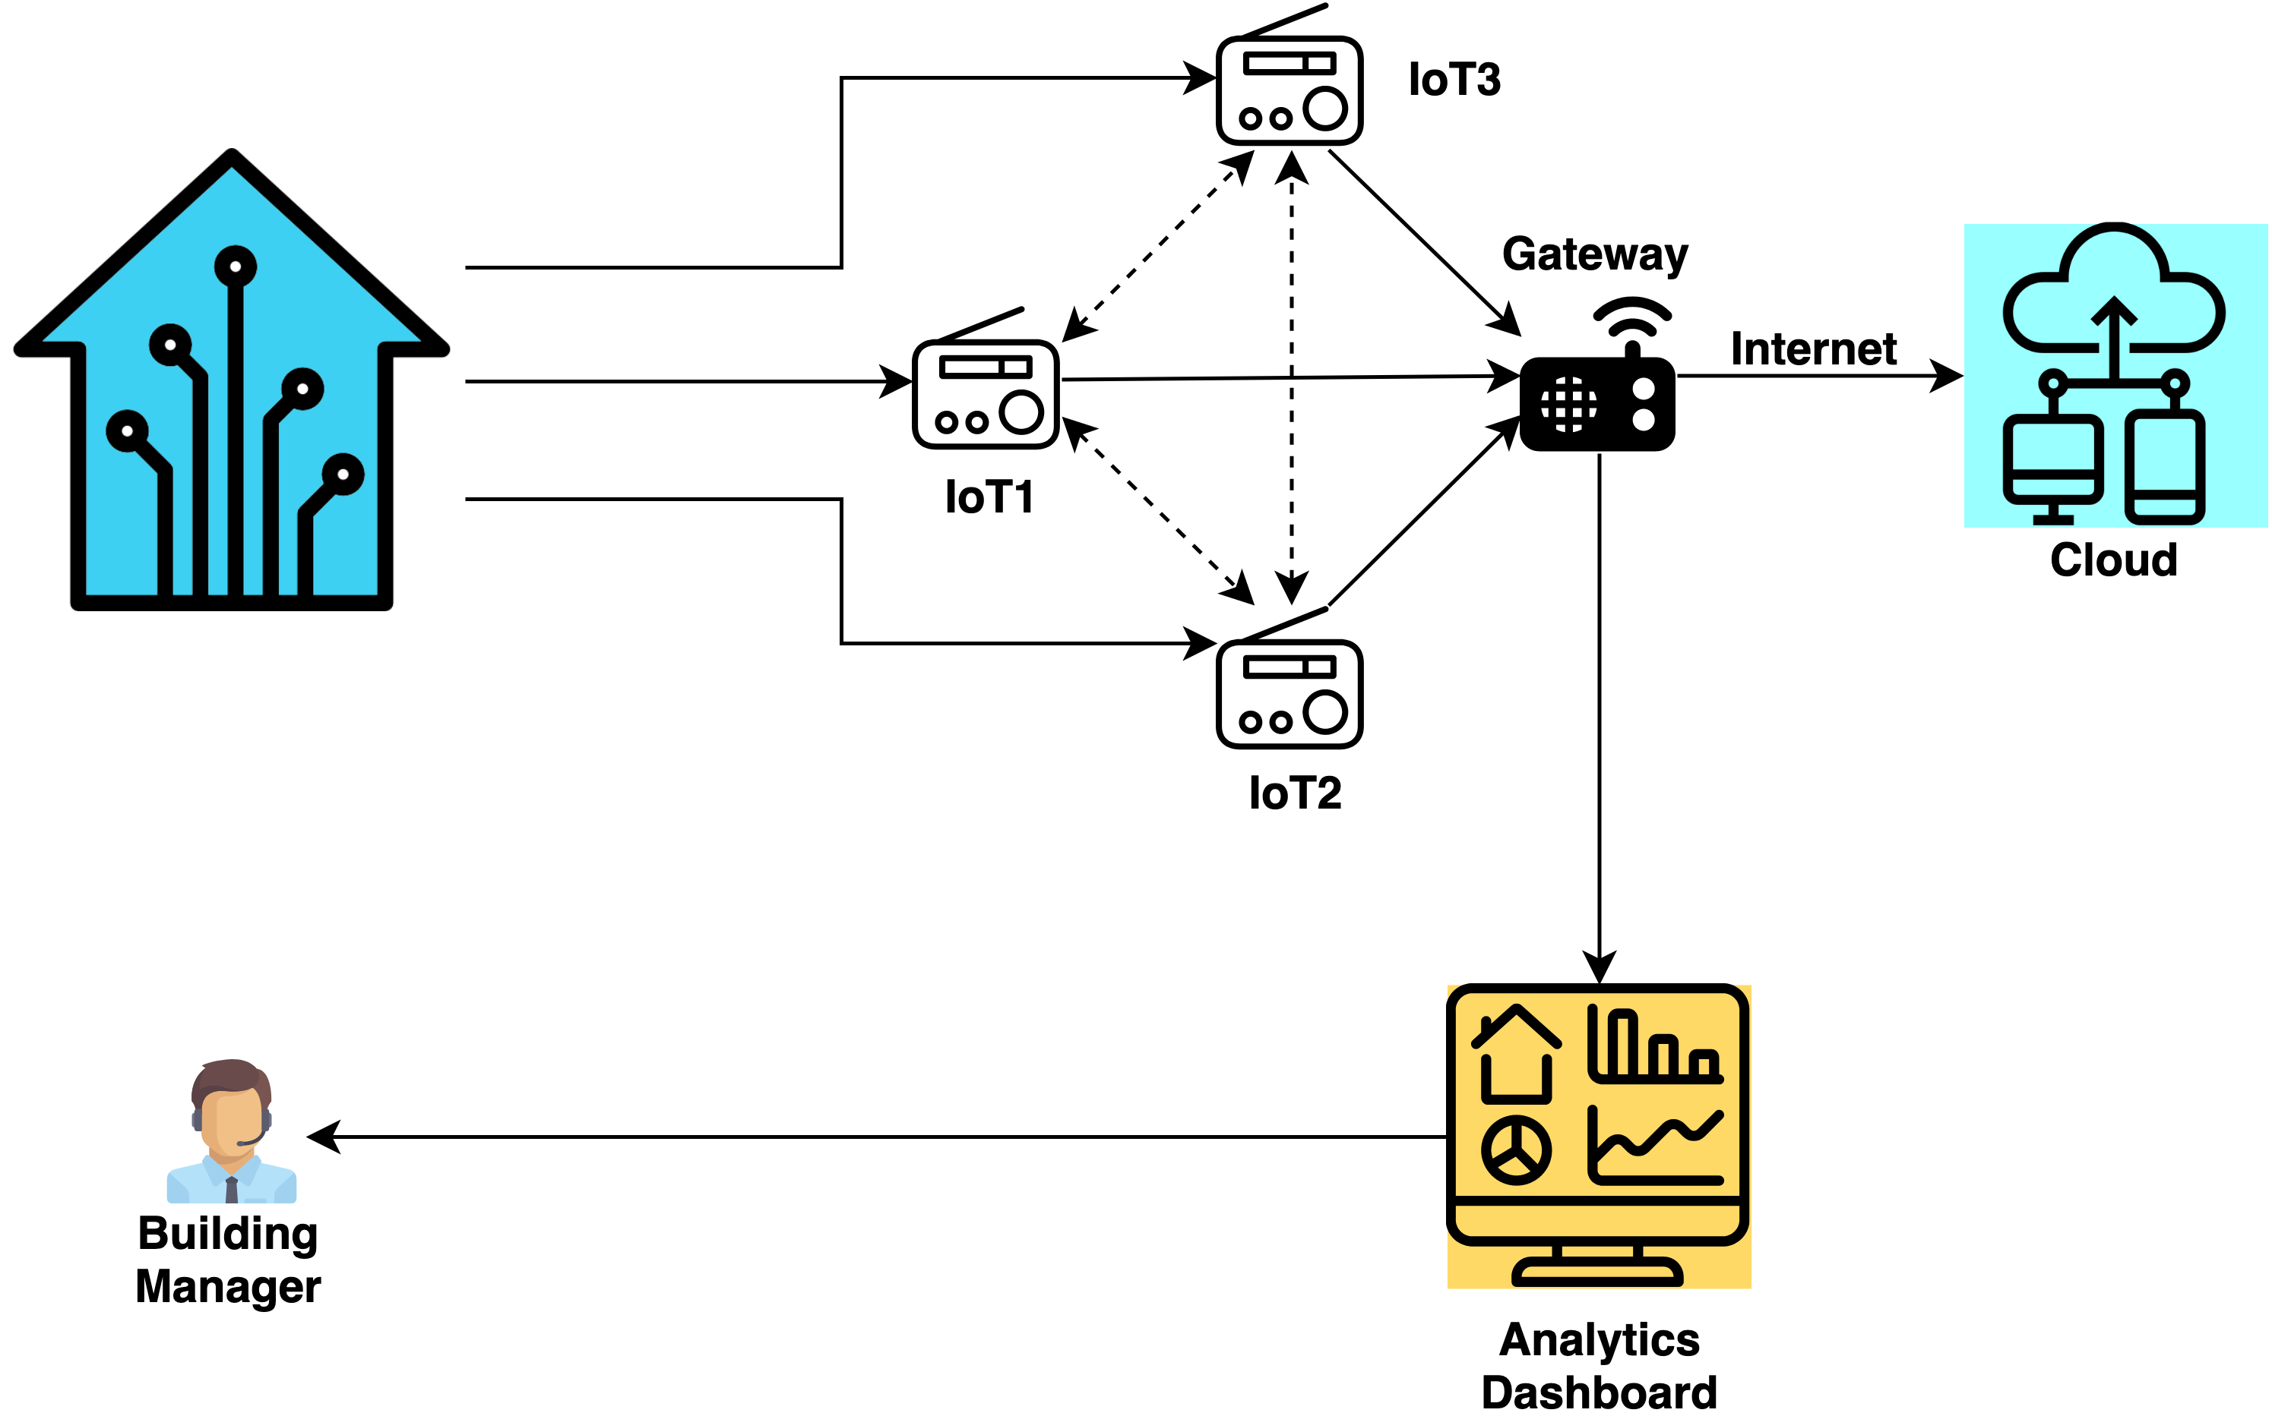
Smart HVAC Management
HVAC MANAGEMENT
Notes:
HVAC Management -
In case of HVAC management, (Heat Ventillation Air Conditioning unit) data captured by heat sensors can be utilized by AI tool to do automatic temperature control in the building.
https://www.forbes.com/sites/cognitiveworld/2019/08/13/how-ai-is-making-buildings-smart-and-intelligent/#58abe56628d7

Slide 7

Challenges in Smart Building
DATA CORRUPTION
CYBER BREACH
Notes:
All these AI tools are data driven.
What if due to power surge or some voltage fluctuation, data captured by the sensors get some noise introduced.
Or what if a cyber hacker hacks into one device and corrupts the data.
It may cause some wrong workflows to be triggered and it may cause a disaster.
https://www.forbes.com/sites/cognitiveworld/2019/08/13/how-ai-is-making-buildings-smart-and-intelligent/#58abe56628d7

Slide 8

Anomaly detection is critical
Notes:
And that is why Anomaly detection is critical

Slide 9
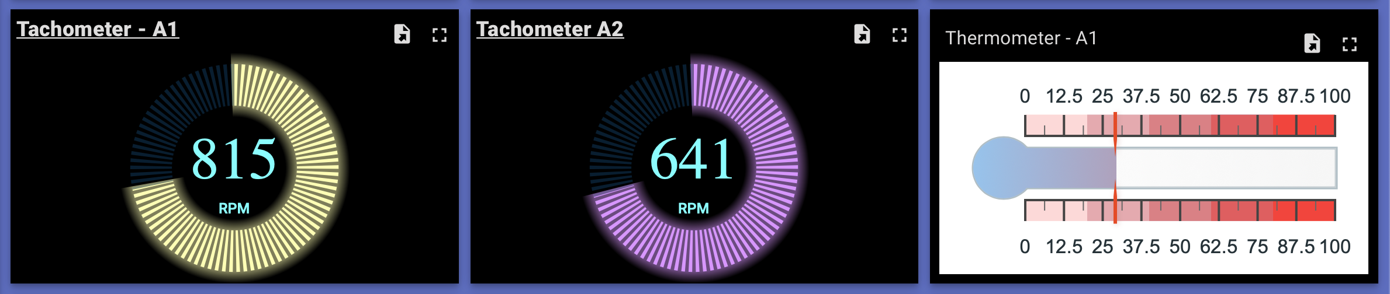
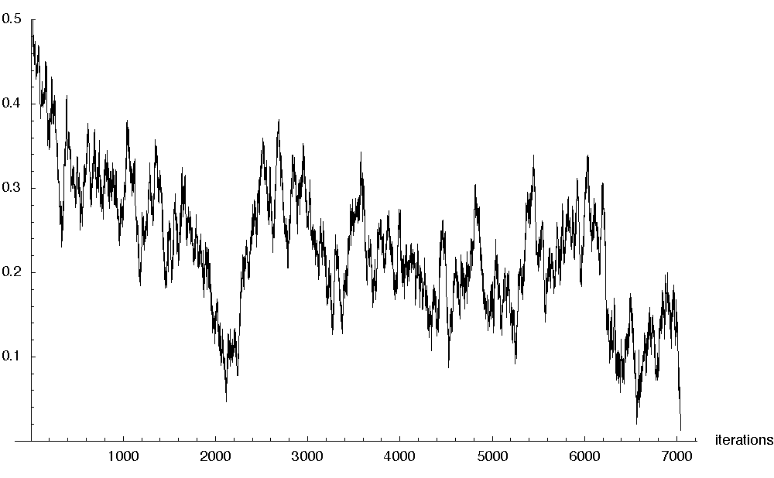
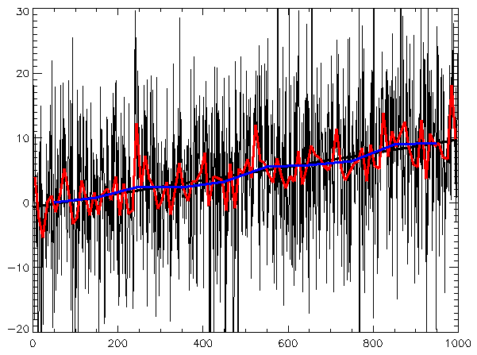
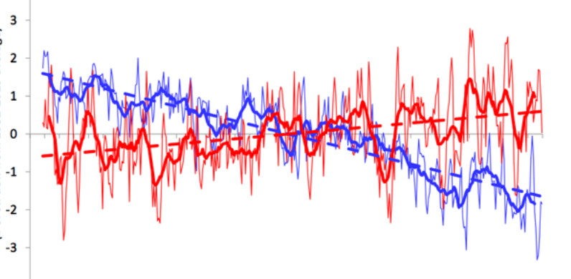
The core is a stream of time series events and the goal is to find anomalies in them
SENSORS’ APPLICATION LEVEL DATA
SENSORS’ NETWORK LEVEL DATA
Notes:
So the idea is to capture the time series event to find anomalies in them.
So what are the data available?
Sensors capture 2 kinds of data.
Application level data – i.e. temperature, pressure, rpm, light intensity etc. using which we can identify if there is some noise in the data.
Network level data – i.e number of bytes received and sent, src_ip, dst_ip etc. using which we can identify if there is an existing bad network configuration or there is some unwanted instrusion in the IoT network.

Slide 10



The current standard practice is to build ML on Centralized data
AI/ML
Notes:
So how it is solved now using cloud computing?
Data captured from all the IoT devices are sent to a centralized data server and AI models are built on the cloud using that data. Once the model is built its deployed on the cloud and exposed through a REST endpoint.
But this kind of set up is not ideal for IoT ecosystem.

Slide 11
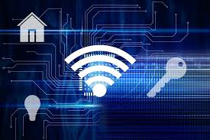
But connected devices present a number of novel challenges
INTERMITTENT
INTERNET CONNECTION
Notes:
GDPR – general data protection regulation by EU.
CCPA – california consumer protection act.

Slide 12

But connected devices present a number of novel challenges
INTERMITTENT
INTERNET CONNECTION
HIGH DATA VOLUME AND VELOCITY
Notes:
GDPR – general data protection regulation by EU.
CCPA – california consumer protection act.

Slide 13
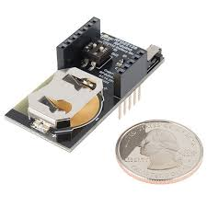
But connected devices present a number of novel challenges
INTERMITTENT
INTERNET CONNECTION
LIMITED BATTERY
HIGH DATA VOLUME AND VELOCITY
Notes:
GDPR – general data protection regulation by EU.
CCPA – california consumer protection act.

Slide 14
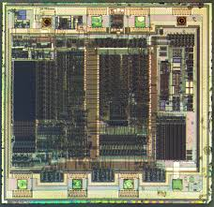
But connected devices present a number of novel challenges
INTERMITTENT
INTERNET CONNECTION
LIMITED BATTERY
HIGH DATA VOLUME AND VELOCITY
LIMITED MEMORY AND PROCESSING POWER
Notes:
GDPR – general data protection regulation by EU.
CCPA – california consumer protection act.

Slide 15

But connected devices present a number of novel challenges
INTERMITTENT
INTERNET CONNECTION
LIMITED BATTERY
DATA PRIVACY
HIGH DATA VOLUME AND VELOCITY
LIMITED MEMORY AND PROCESSING POWER
Notes:
GDPR – general data protection regulation by EU.
CCPA – california consumer protection act.

Slide 16

Federated Learning is here to rescue!!
Decentralized learning
Secure computing
Preserve privacy
Notes:
Federated Learning is a machine learning setting where the goal is to train a high-quality centralized model with training data distributed over a large number of clients each with unreliable and relatively slow network connections.

Slide 17

Steps for Federated Learning
Federation Construction.
Decentralized Training.
Model Accumulation.
Model Aggregation (FedAvg).
Notes:
Federated Learning is a machine learning setting where the goal is to train a high-quality centralized model with training data distributed over a large number of clients each with unreliable and relatively slow network connections.

Slide 18



(a) Federation Construction
Pre-trained model
A random subset of members of the devices is selected to receive the global model synchronously from the server.
Notes:
So how does federation construction happen?
The pretrained model from the cloud is sent to the devices.

Slide 19




(b) Decentralized Training
Data
Data
Data
Data
Each selected device computes an updated model using its local data.
Notes:
Then each of these devices incrementally train the model using their own data. As you can clearly see the devices does not share their data while training the individual models.

Slide 20
(c) Model Accumulation
Only the model updates are sent from the federation to the server. Data is not moved.
Notes:
After the decentralized training is done, the gradient updates of the individual models are sent to the cloud. As you can see the data remains on the respective devices.

Slide 21
(d) Model Aggregation
Federated Average
The server aggregates these model weights (typically by averaging) to construct an improved global model.
Notes:
The server then aggregates these gradient updates to construct the improved global model. This is typically done by averaging which is known as Federated Average algorithm.

Slide 22

Federated Learning (Rinse, Repeat)
The devices receive the updated model.
Notes:
And the whole process is kept on repeating.

Slide 23
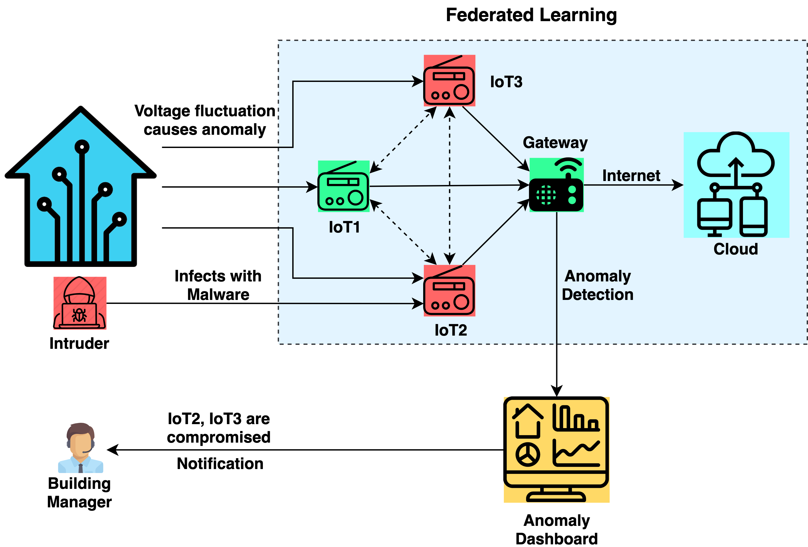
Use Case
Notes:
Anomaly detection for smart building, we are using single party federated learning though it can be done in multi-party set up.
On the left top you can see the blue smart home. It is monitored by 3 IoT devices or the sensors for eg. Heat sensor, pressure sensor, light intensity sensor. The sensors are connected to the gateway through bluetooth. Gateways are a bit powerful devices for eg raspberry pie. The gateway is connected to the internet and also powers the anomlay dashboard which the building manager has access to. The AI based anomaly detection model is deployed on the gateway itself.
Now consider a situation,
There is a voltage fluctuation and it adds some noise to the captured data by the sensor IoT3. On the other hand, a malicious intruder infects the sensor IoT2 with malware at the network level.
The AI model deployed on the gateway detects this abberation in the application level data as well as the network level data and sends notification to the building manager that IoT2 and IoT3 are compromised.

Slide 24
Tools- Choices
Notes:
TensorFlow Federated (TFF) is an open-source framework for machine learning and other computations on decentralized data. TFF has been developed to facilitate open research and experimentation with Federated Learning (FL)
PySyft is a Python library for secure, private Deep Learning. PySyft decouples private data from model training, using Federated Learning, Differential Privacy, and Multi-Party Computation (MPC) within PyTorch.
FATE (Federated AI Technology Enabler) is an open-source project initiated by Webank's AI Department to provide a secure computing framework to support the federated AI ecosystem. It implements secure computation protocols based on homomorphic encryption and multi-party computation (MPC).

Slide 25
We use PySyft
Our journey
Rules + Z-score
K-Means + Isolation Forest + Oneclass SVM
Deep Auto-Encoder
Federated Learning
Unsupervised
Unsupervised + Supervised
Notes:
Talk more about it.

Slide 26
Demo
The notebook can be found here:-
https://github.com/tuhinsharma121/federated-ml/blob/master/notebooks/network-threat-detection-using-federated-learning.ipynb

Slide 27
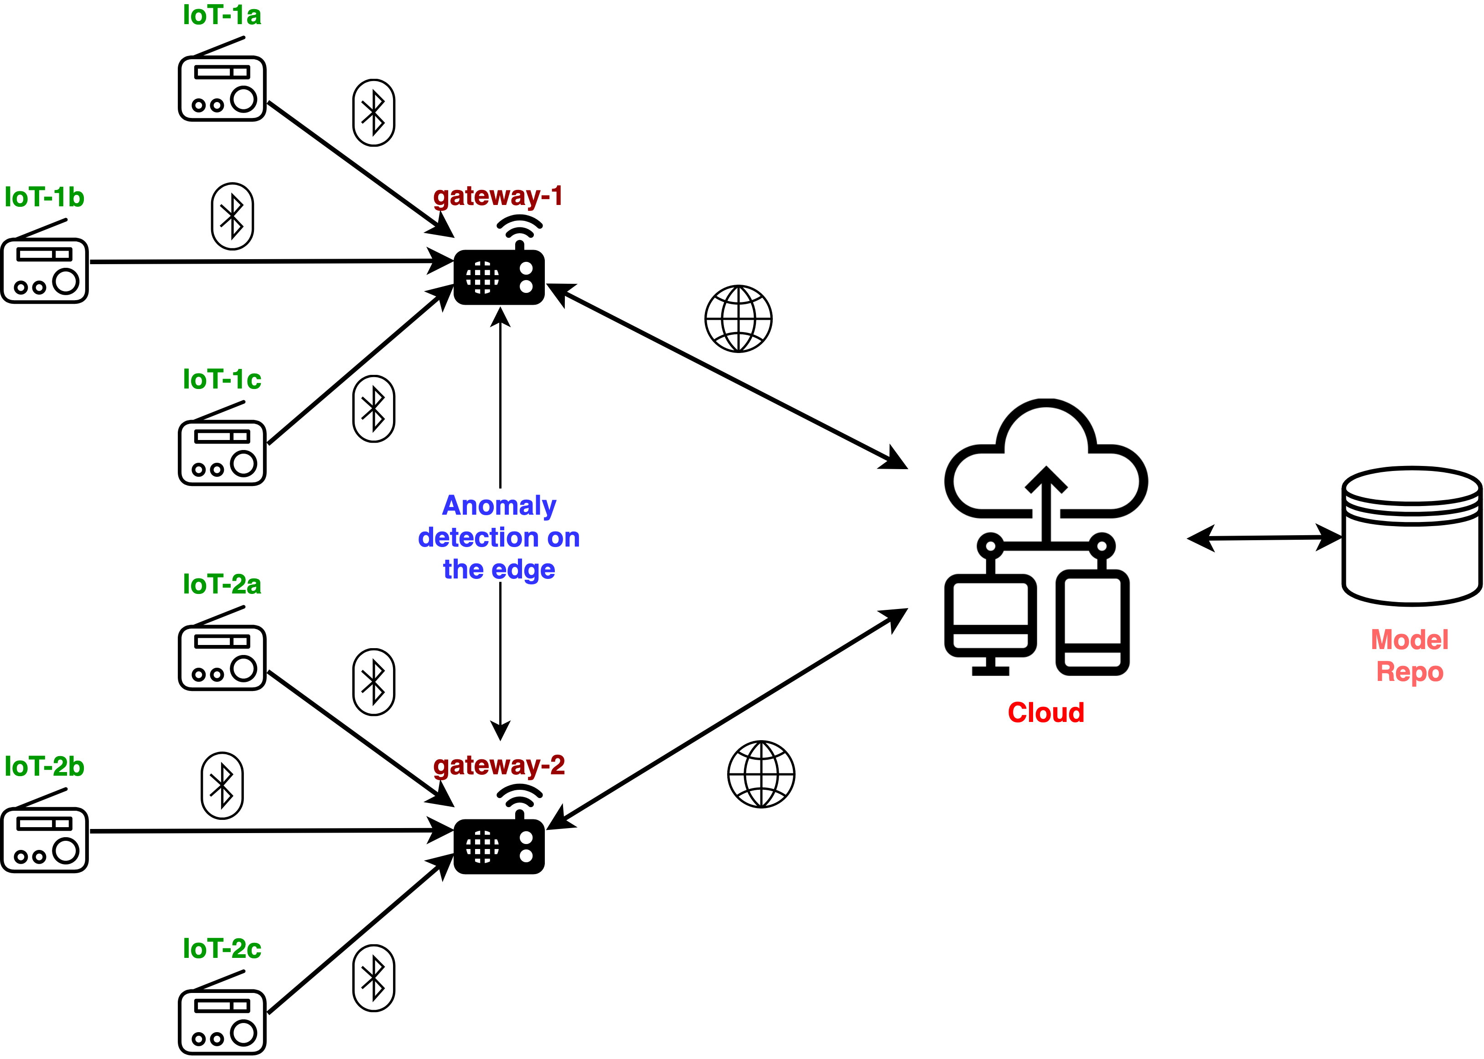
Demo use case
Capture data.
Construct feature matrix
Train/Test Split
Setup environment
Prepare federated data.
Train model in federated way.
Save, Load, Predict.

Slide 28
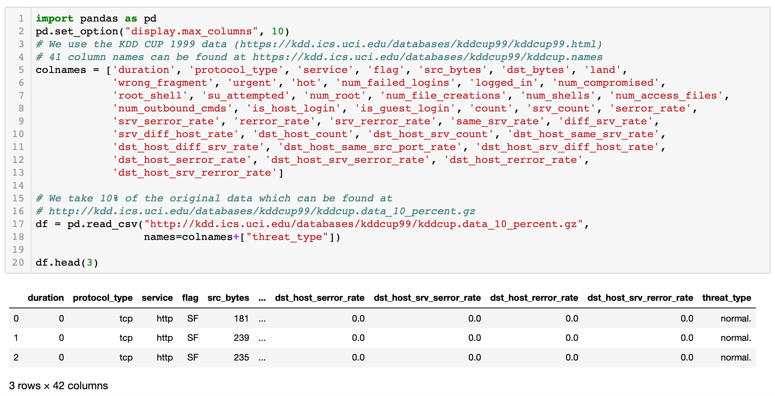
Capture data

Slide 29
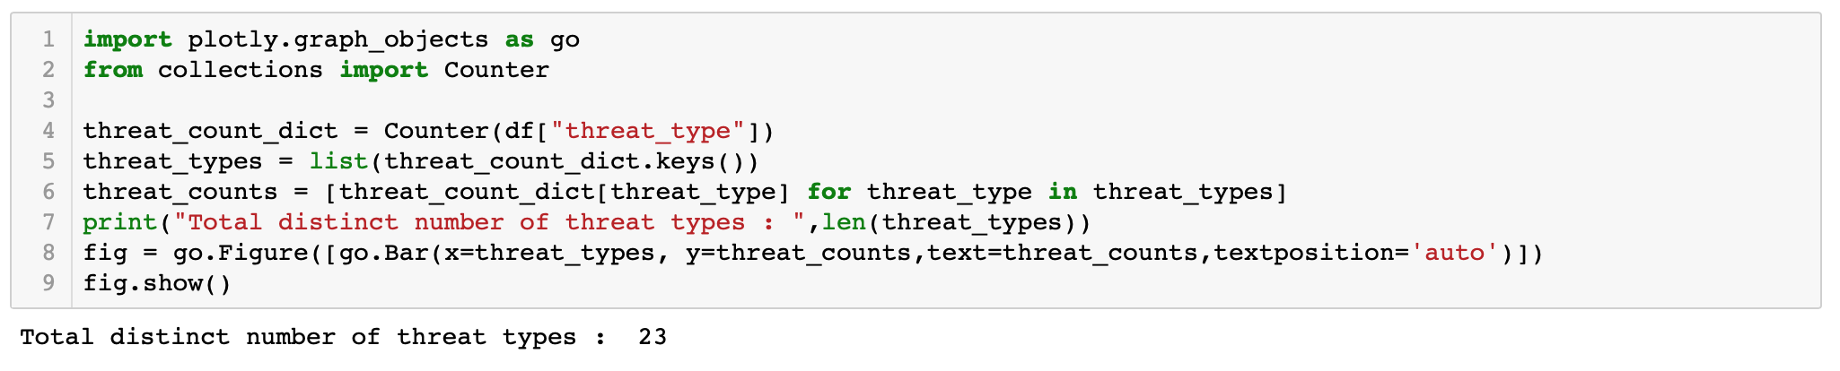
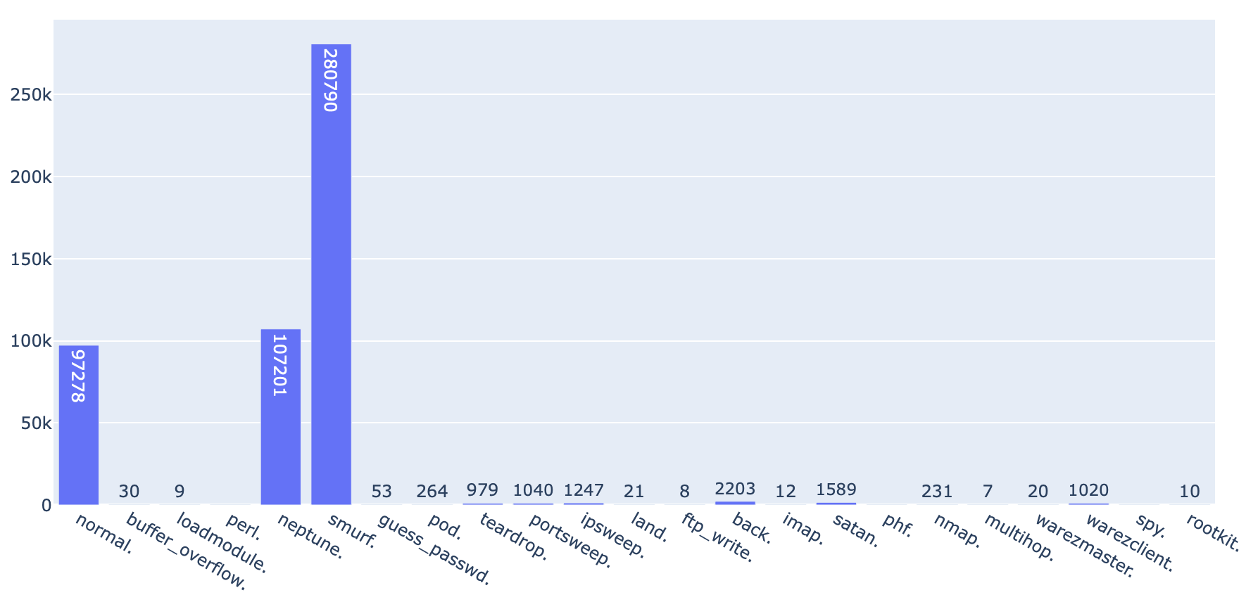
Threat type distribution

Slide 30
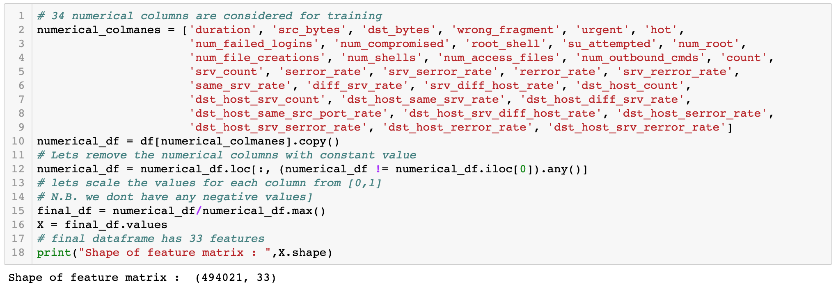
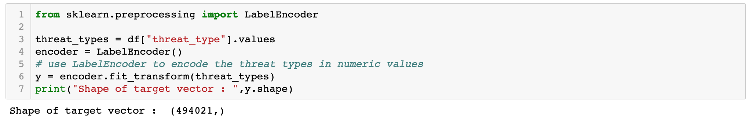
Construct feature matrix and target vector

Slide 31
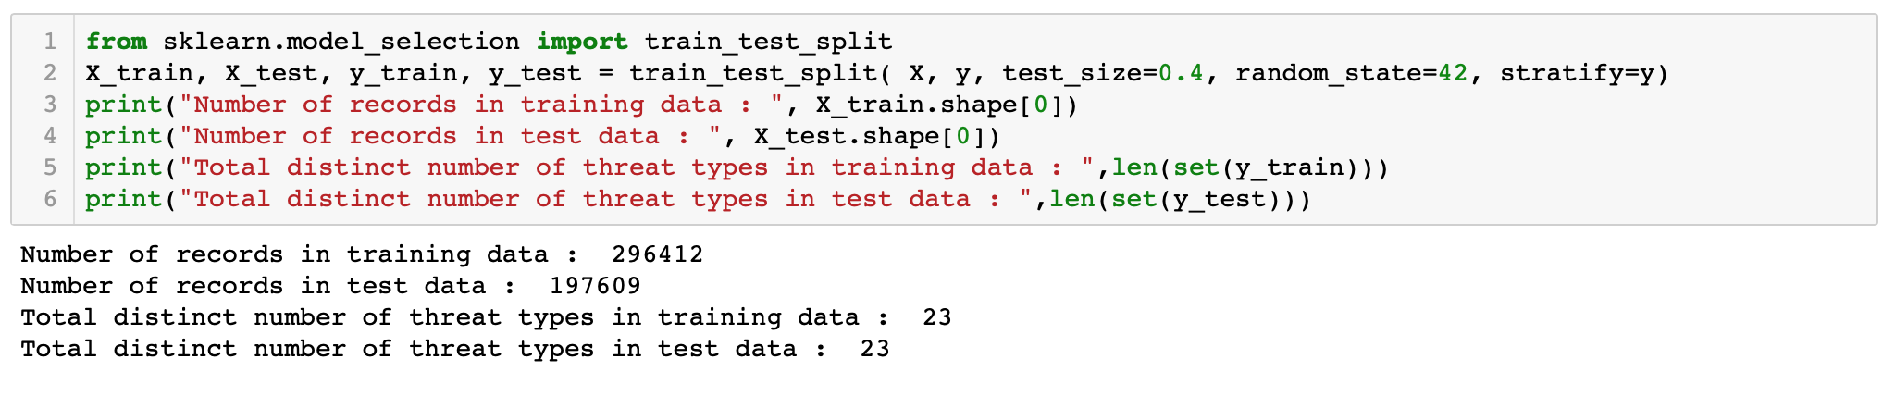
Train/Test split
Stratified sampling preserves the class distribution after the split

Slide 32
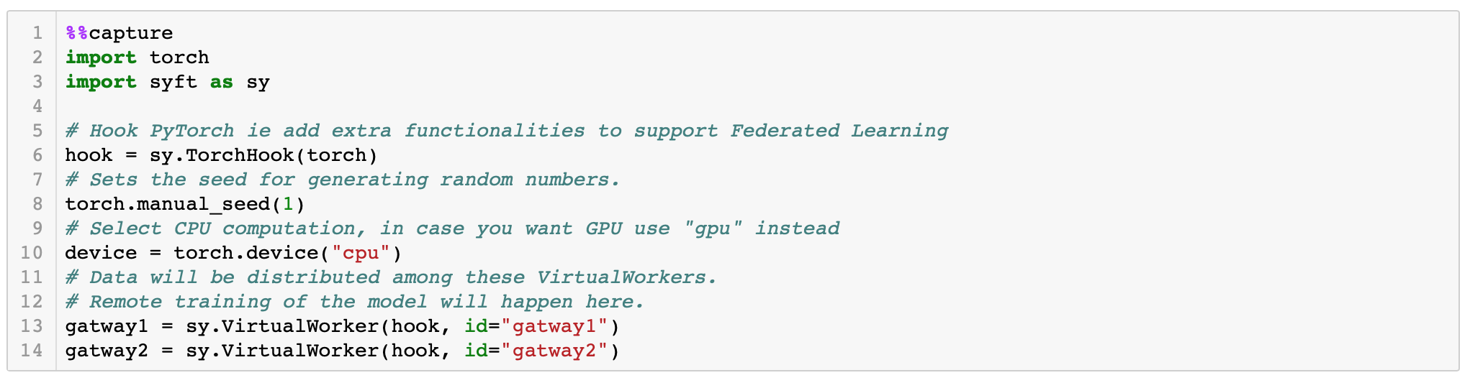
Lets set up the environment for federated learning
In these 2 gateways data will reside and models will be trained

Slide 33
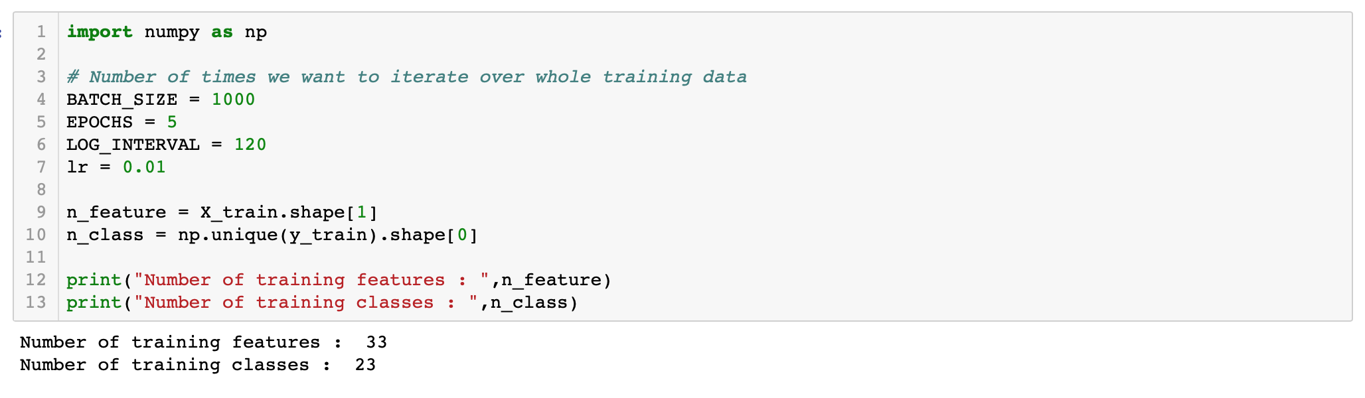
Lets set the training parameters

Slide 34
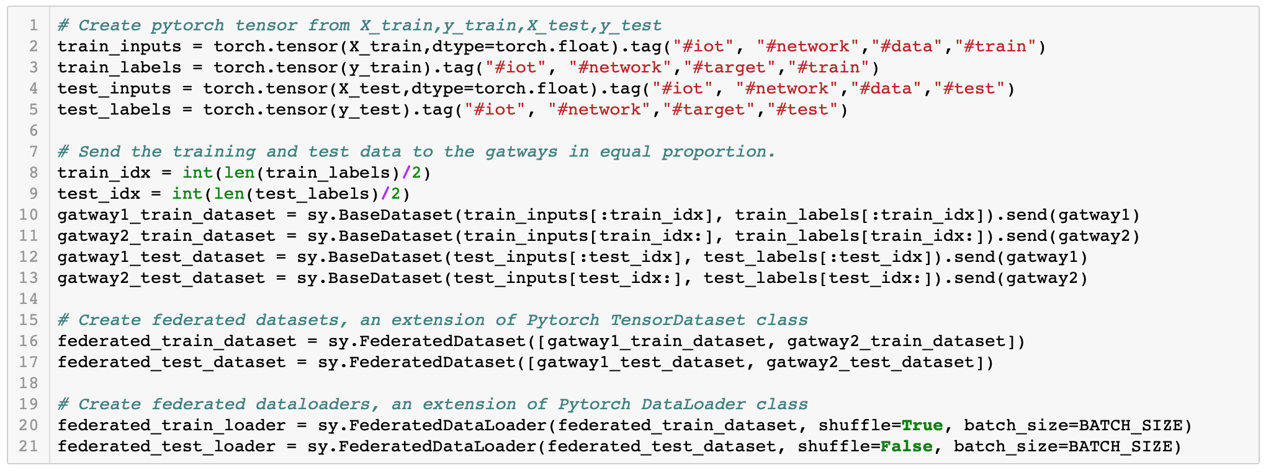
Prepare federated data and distribute across the gateways

Slide 35
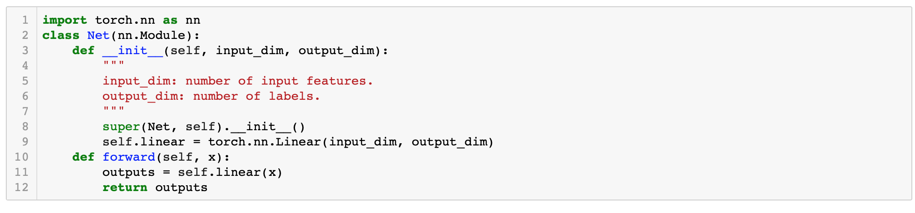
Lets define a simple logistic regression model
It can be any PyTorch DL model

Slide 36
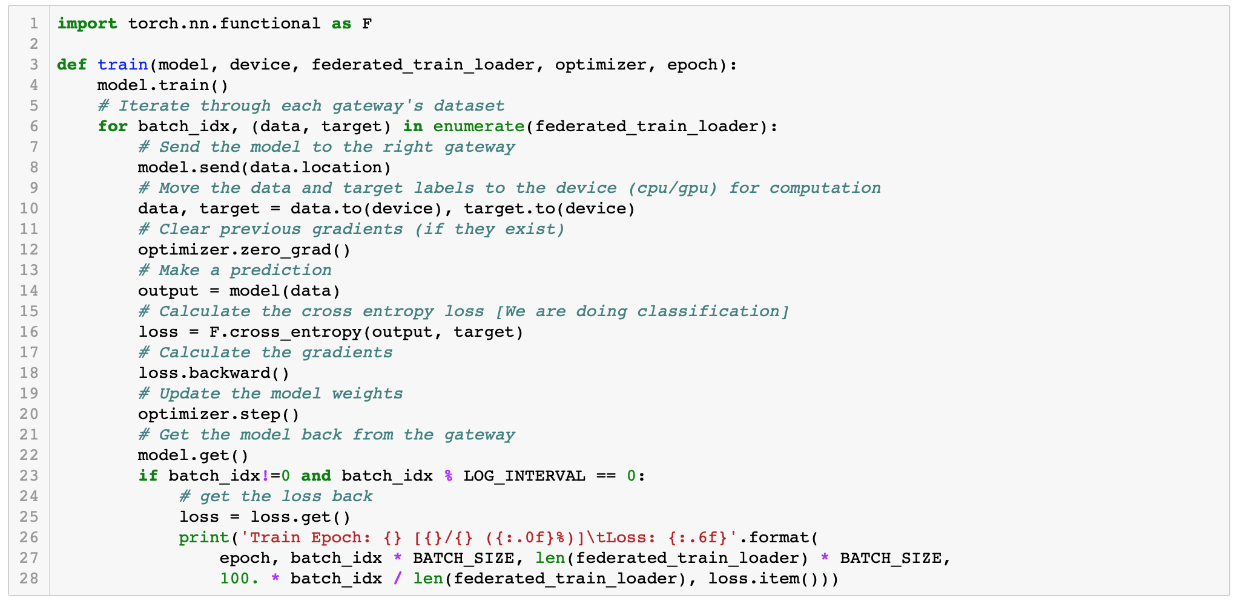
Lets define the training process

Slide 37
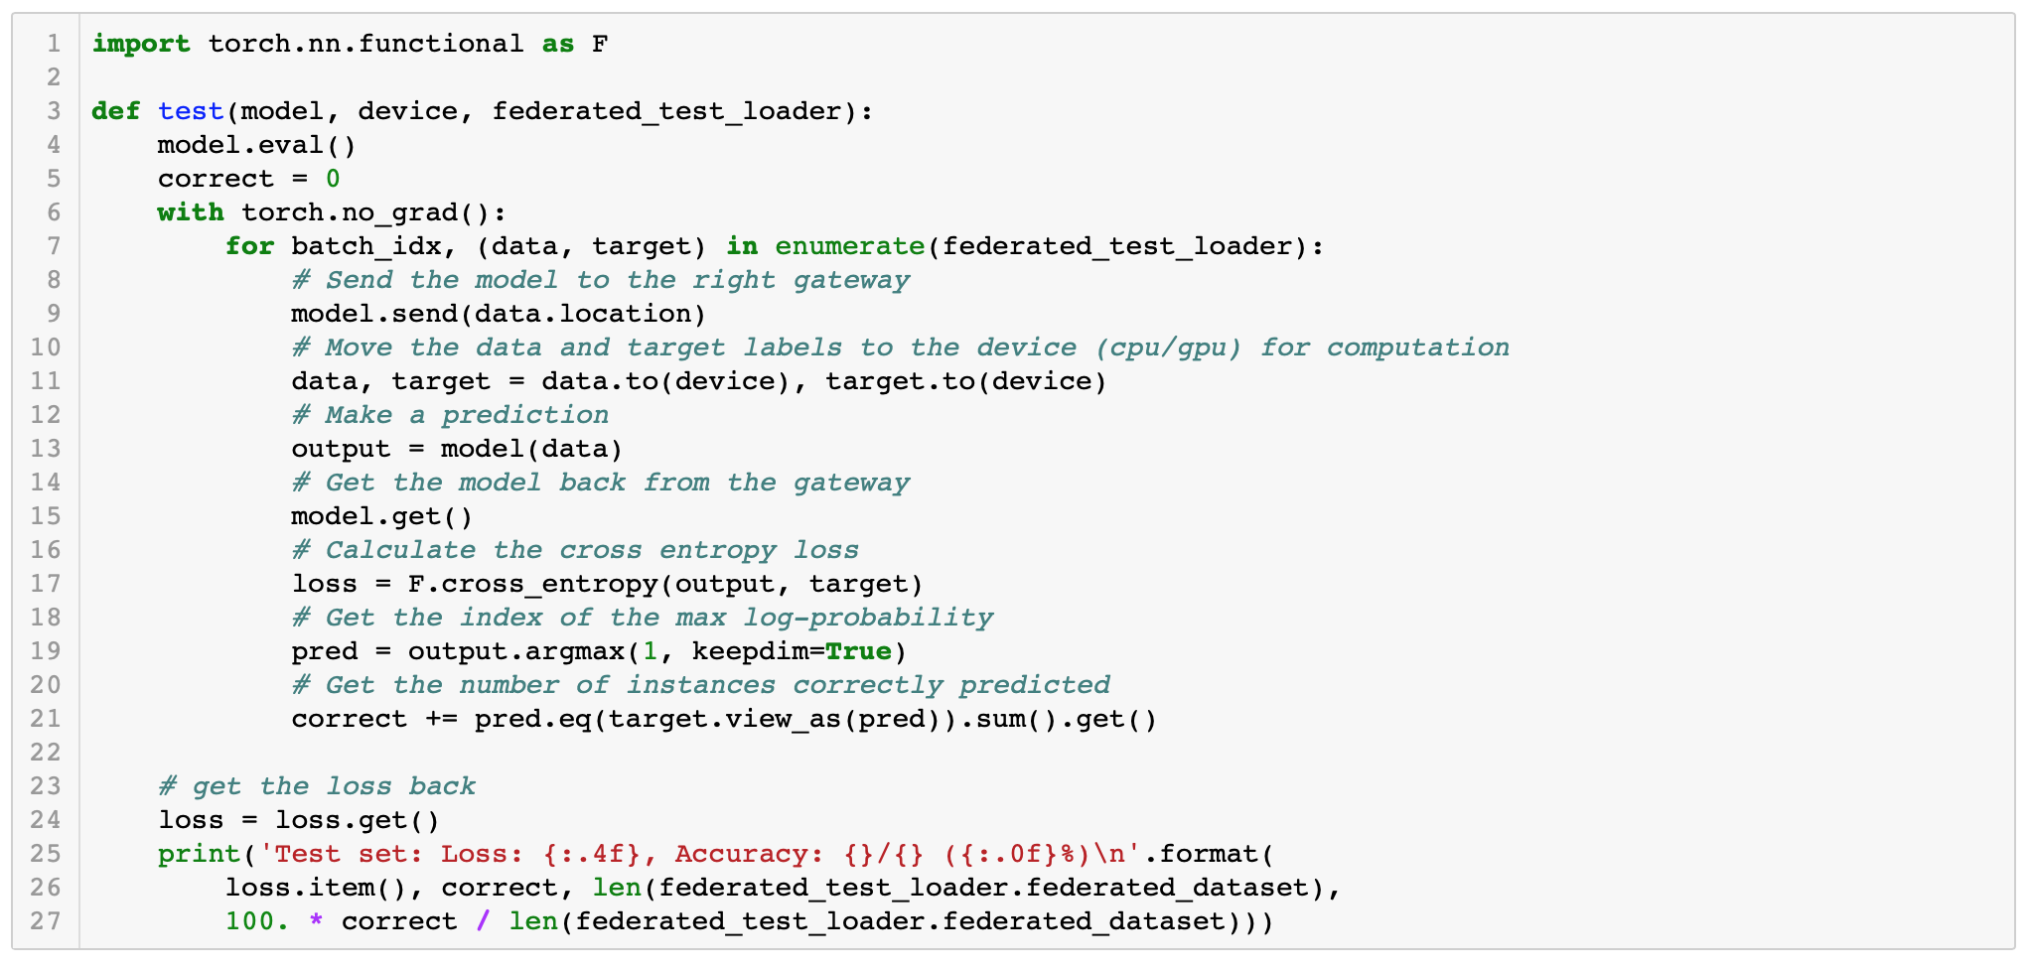
Lets define the validation process

Slide 38
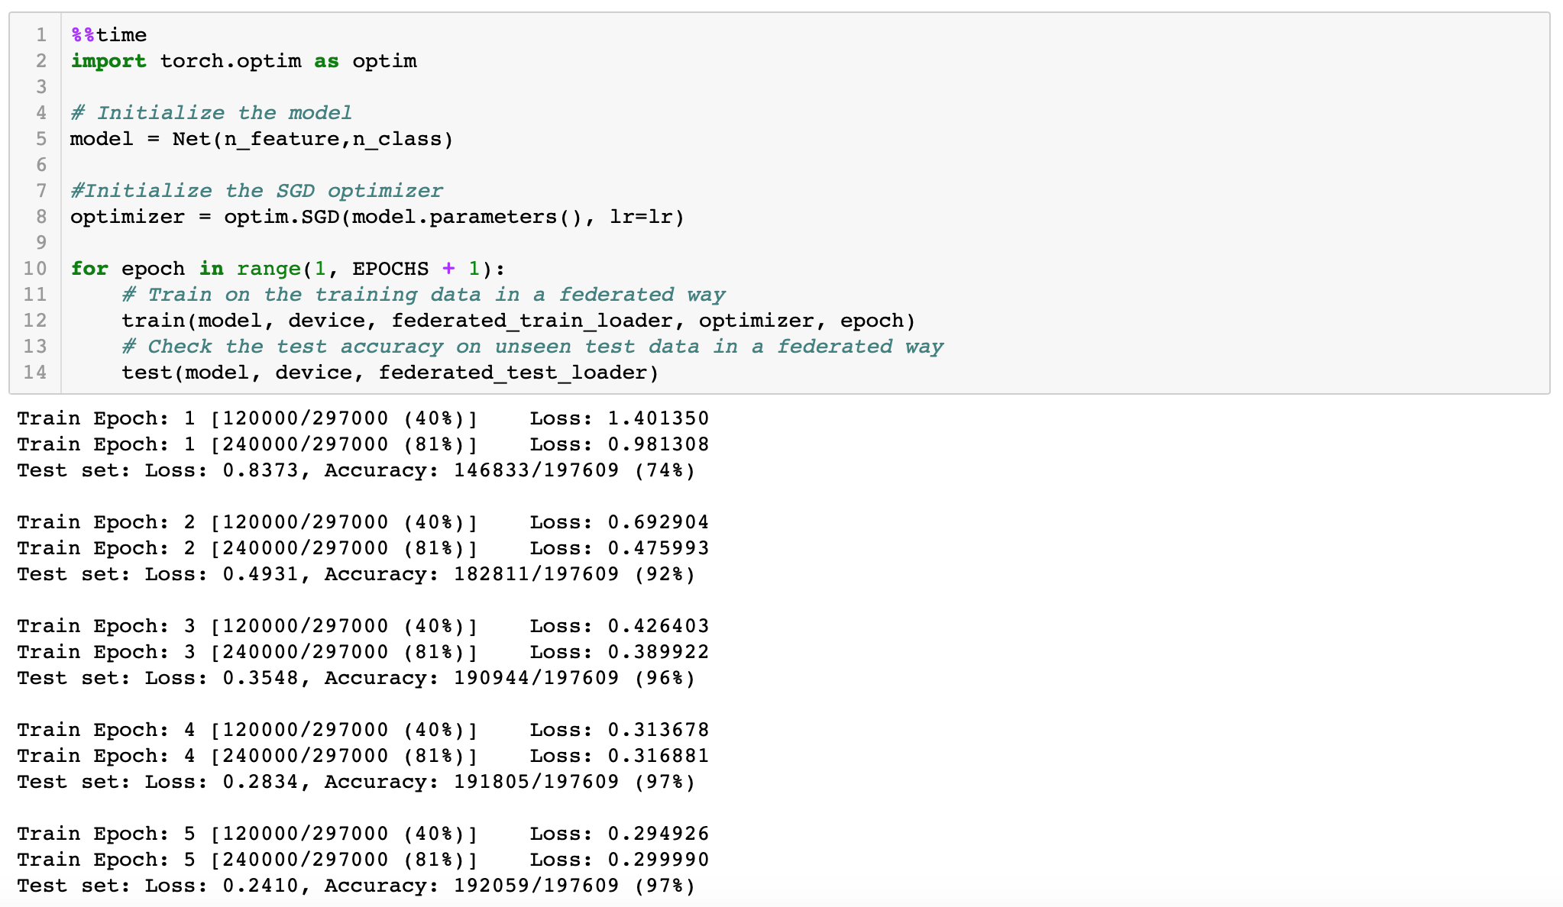
Lets train the model in federated way

Slide 39
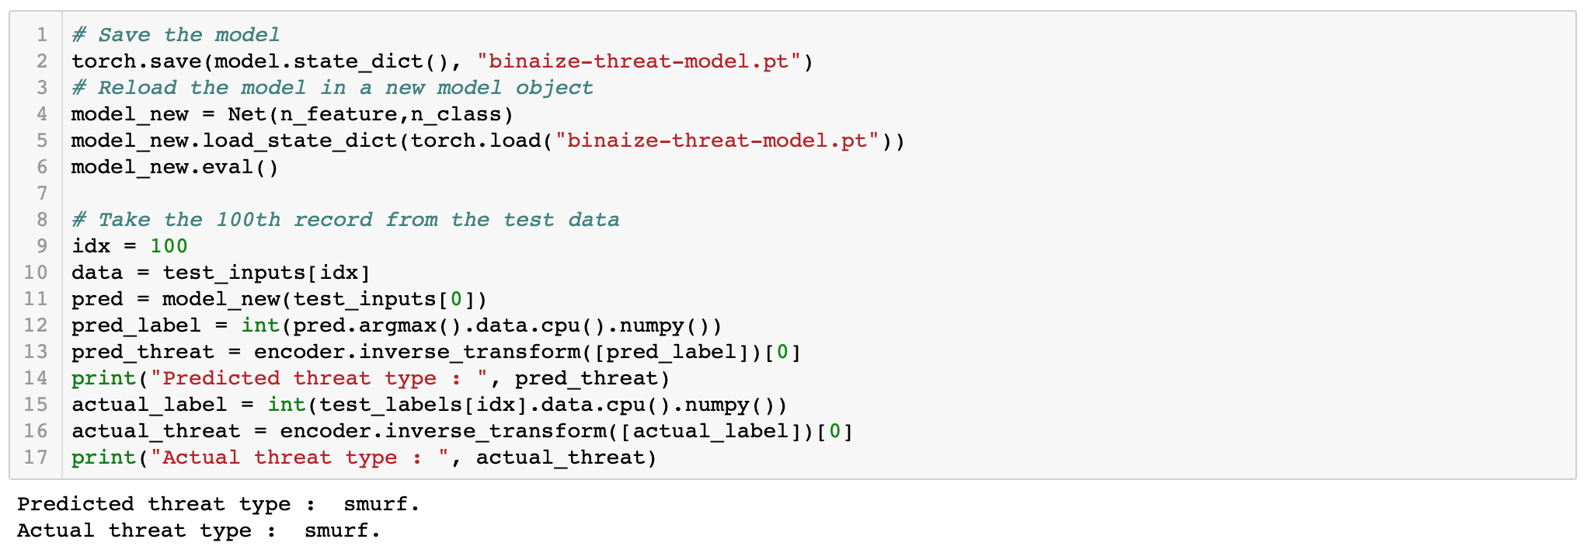
Save, Reload and Use the model to predict one network traffic data

Slide 40
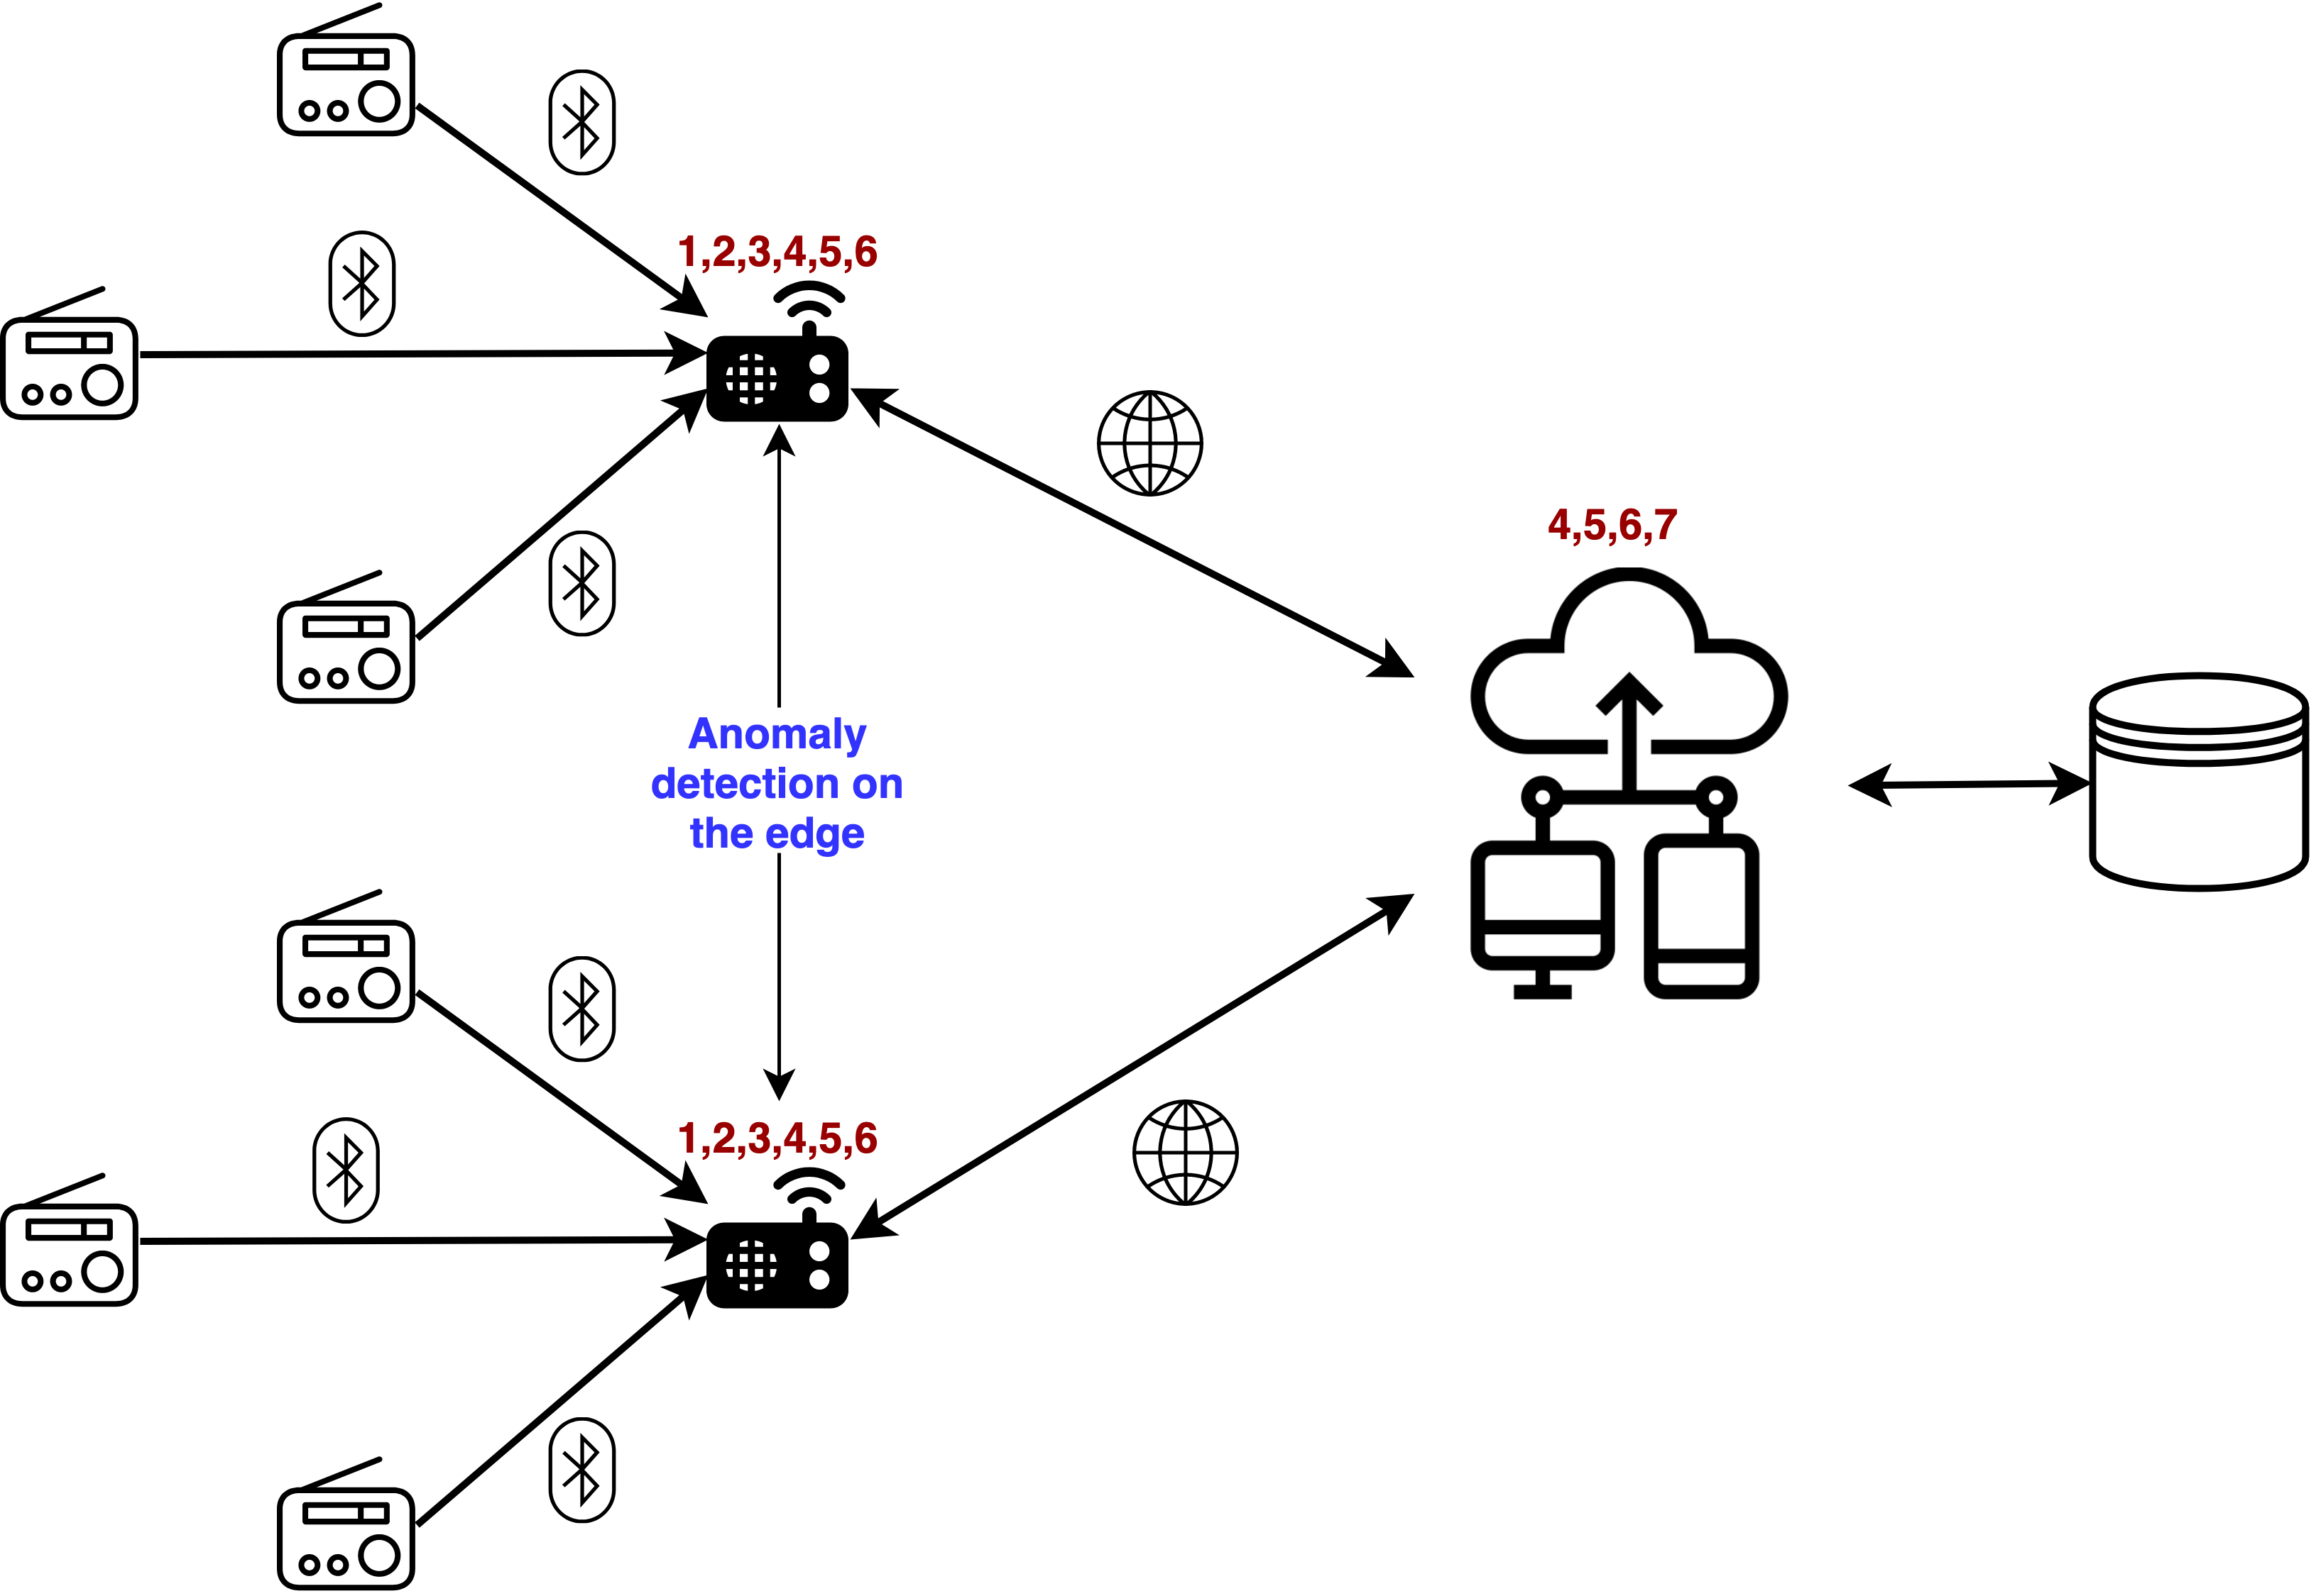
Demo use case
Capture data.
Construct feature matrix
Train/Test Split
Setup environment
Prepare federated data.
Train model in federated way.
Save, Load, Predict.

Slide 41
Some of our design choices
Tensorflow
Lite
Pytorch
Mobile
Prunning
Quantization
Graph → C++
Notes:
Quantization refers to techniques for performing computations and storing tensors at lower bitwidths than floating point precision.
Pruning : Removing redundant connections present in the architecture. Pruning involves cutting out unimportant weights.
Need good estimate of device usage !

Slide 42
Types of Federated Learning
SINGLE PARTY FEDERATED LEARNING
MULTI PARTY FEDERATED LEARNING.
Notes:
Lets talk about the types of federated learning. There are 2 types: -
Single party and multi party

Slide 43


Single Party Federated Learning
Music recommendation engine
only one entity is involved in governance of the distributed data capture and flow system
Notes:
In a Single Party system, only one entity is involved in governance of the distributed data capture and flow system. This could be in several forms such as a smartphone or IoT app, network devices, distributed data warehouses etc.
Models are trained in a Federated manner on data that has the same structure across all client devices and in most cases each data point is unique to the device or user.
For example, a music recommendation engine, which recommends music on an app for users, can be Federated this way.
https://hackernoon.com/a-beginners-guide-to-federated-learning-b29e29ba65cf
https://medium.com/datadriveninvestor/an-overview-of-federated-learning-8a1a62b0600d

Slide 44
Multi Party Federated Learning
Vertical FL
ORG A
ORG B
features
Horizontal FL
clients
Notes:
Keeping data private is the major value addition of Federated Learning here for each of the participating entities to achieve a common goal.
The data structures and parameters are usually similar
a lot of pre-processing is required at each client to standardize model inputs.
A neutral 3rd party could be involved in providing the infrastructure to aggregate model weights and establish trust among the clients.
Pink rectangle: Horizontal : Take the case of two regional banks. Although they have non-overlapping clientele, their data will have similar feature spaces since they have very similar business models. They might come together to collaborate in an example of horizontal federated learning.
Red rectangle: Vertical: In vertical federated learning, two companies providing different services (e.g. banking and e-commerce) but having a large intersection of clientele might find room to collaborate on the different feature spaces they own, leading to better outcomes for both.
https://hackernoon.com/a-beginners-guide-to-federated-learning-b29e29ba65cf
https://medium.com/datadriveninvestor/an-overview-of-federated-learning-8a1a62b0600d

Slide 45
Challenges in Federated Learning
Inference Attack.
Model Poisoning.
Notes:
Inference Attacks:
the repeated model weight updates can be exploited to reveal properties not global to the data but specific to individual contributors. This inference can be performed on both the server side as well as (other) client side.
Model Poisoning :Some researchers have investigated the possibility of misbehaving clients introducing backdoor functionality or mounting Sybil attacks to poison the global model.
https://medium.com/datadriveninvestor/an-overview-of-federated-learning-8a1a62b0600d

Slide 46
Inference Attack
Model deltas encode subtle variations of user specific information.
Possible to de-anonymize participating devices using a limited set of auxiliary data.
Aggregator (global param W^{t+1})
Down : W^{t+1}
Up : W_{N}^{t}
f(x,W₁^{t})
f(x,W₂^{t})
f(x,W_{N}^{t})
D₁
D₂
D_{N}
Notes:
the degree to which user-specific information is encoded in the model deltas is poorly understood. It is proven that model deltas encode subtle variations in which users capture and generate data.
The variations provide a powerful statistical signal, allowing an adversary to effectively deanonymize participating devices using a limited set of auxiliary data.
https://arxiv.org/pdf/1805.05838.pdf

Slide 47
Inference Attack
Model deltas encode subtle variations of user specific information.
Possible to de-anonymize participating devices using a limited set of auxiliary data.
Aggregator (global param W^{t+1})
Down : W^{t+1}
Up : W_{N}^{t}
f(x,W₁^{t})
f(x,W₂^{t})
f(x,W_{N}^{t})
D₁
D₂
D_{N}
Notes:
The attacker could be the central aggregator, who observes individual updates over time and can control the view of the participants on the global parameters.

Slide 48
Inference Attack
Model deltas encode subtle variations of user specific information.
Possible to de-anonymize participating devices using a limited set of auxiliary data.
Aggregator (global param W^{t+1})
Down : W^{t+1}
Up : W_{N}^{t}
f(x,W₁^{t})
f(x,W₂^{t})
f(x,W_{N}^{t})
D₁
D₂
D_{N}
Notes:
It could also be any of the participants who can observe the global parameter updates, and can control his parameter uploads.

Slide 49
Solution: Differential Privacy
Average
Clip
Noise
Notes:
During training, differential privacy is ensured by optimizing models using a modified stochastic gradient descent that averages together multiple gradient updates induced by training-data examples, clips each gradient update to a certain maximum norm, and adds a Gaussian random noise to the final average. This style of learning places a maximum bound on the effect of each training-data example, and ensures that no single such example has any influence, by itself, due to the added noise.

Slide 50
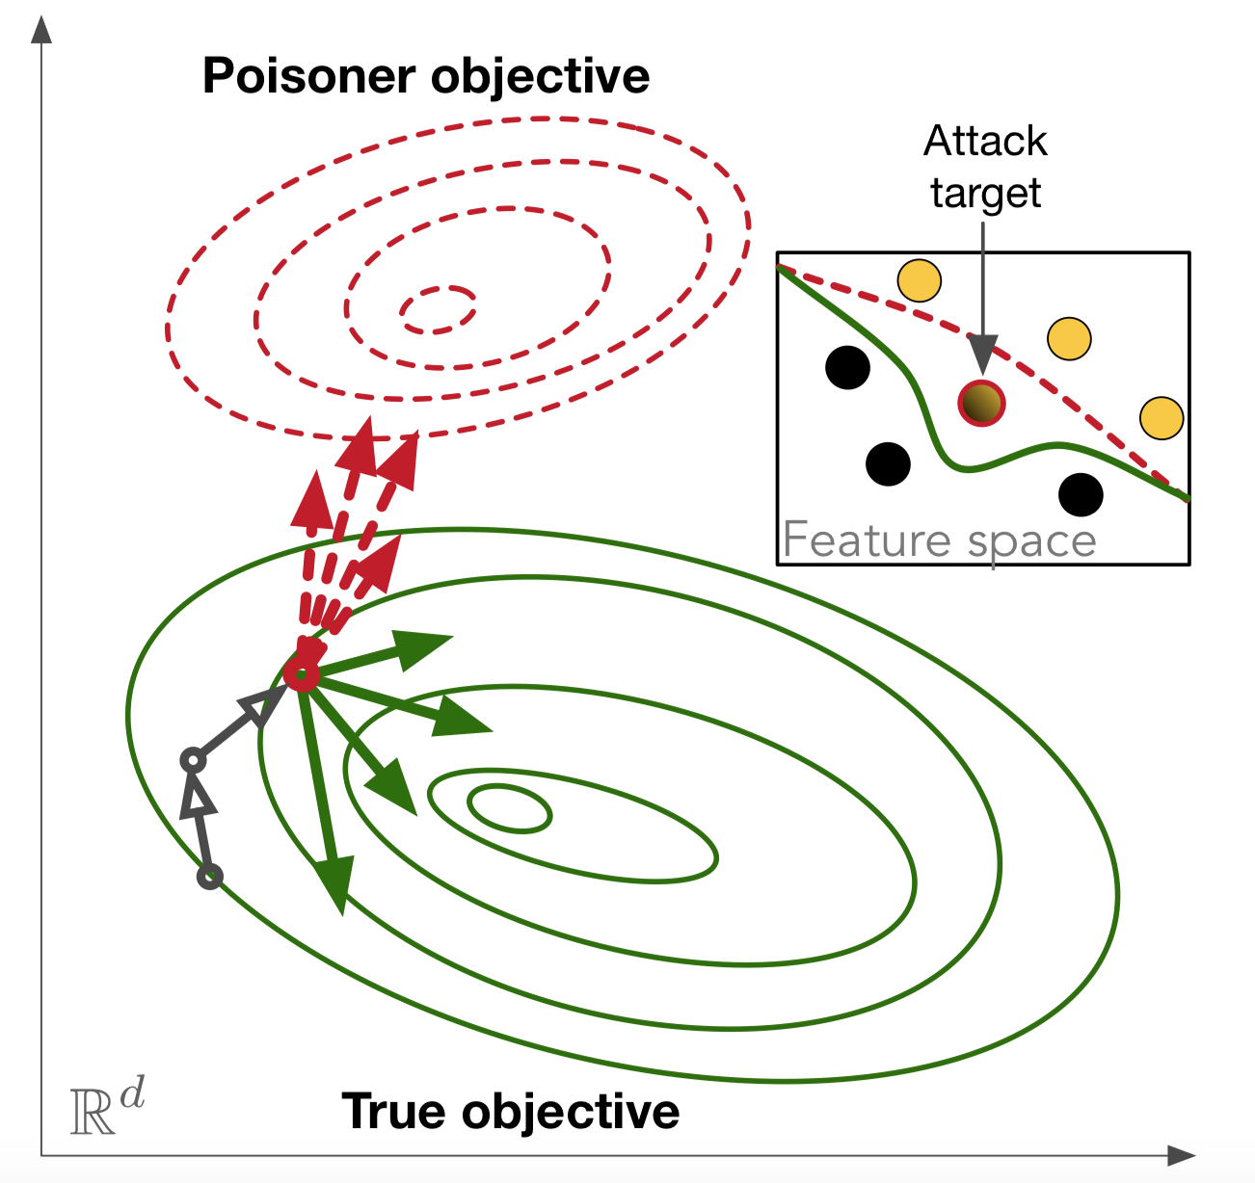
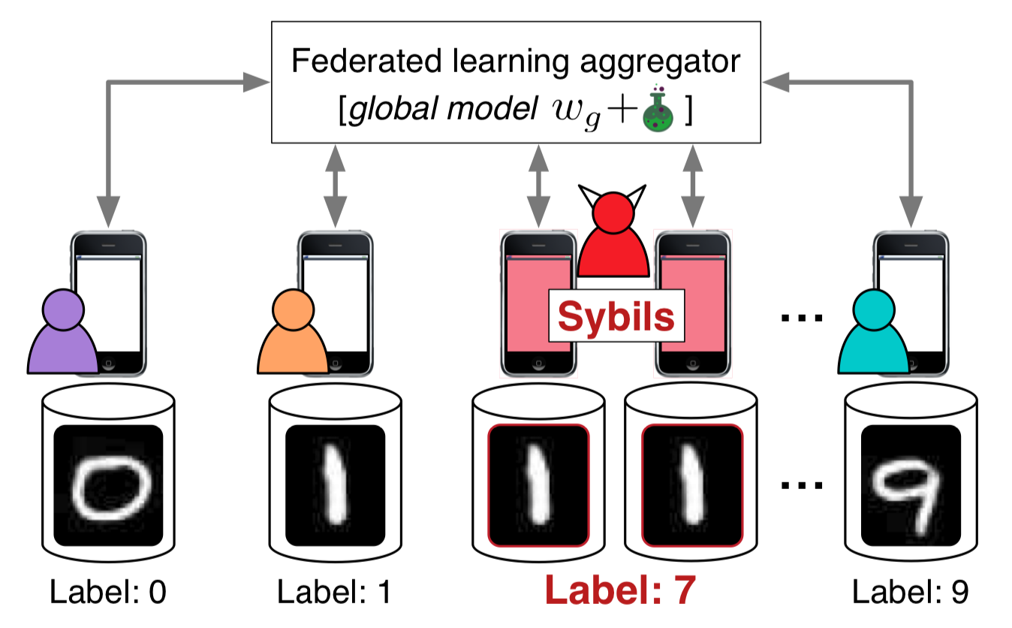
Model Poisoning
Anomaly classified as normal
FL Aggregator
[W^{t} + noise]
Label : 0
Label : 1
Label : 8
Label : 9
Notes:
https://arxiv.org/pdf/1808.04866.pdf
Federated learning with colluding sybils mounting a sybil-based poisoning attack. In the attack two sybils poison the model by computing over images of 1s with the (incorrect) class label 8.
Targeted poisoning attack in SGD. The dotted red vectors are sybil contributions that drive the model towards a poisoner objective. The solid green vectors are contributed by honest clients that drive towards the true objective.
In a Sybil attack, the attacker subverts the reputation system of a peer-to-peer network by creating a large number of pseudonymous identities and uses them to gain a disproportionately large influence. It is named after the subject of the book Sybil, a case study of a woman diagnosed with dissociative identity disorder.^{[1]} The name was suggested in or before 2002 by Brian Zill at Microsoft Research.^{[2]}

Slide 51
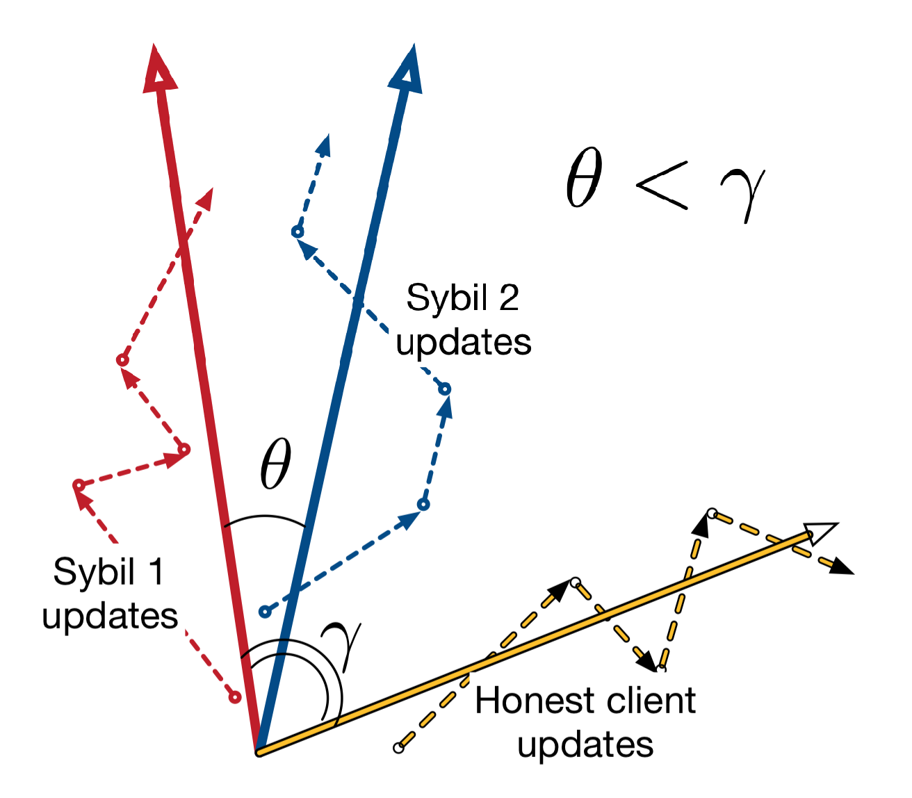
Solution: Sybil Detection
Notes:
https://arxiv.org/pdf/1808.04866.pdf
Dashed lines are gradient updates from three clients (2 sybils, 1 honest). Solid lines are aggregated update vectors. The angle between the aggregated update vectors of sybil clients (θ) is smaller than between those of the honest client and a sybil (γ). Cosine similarity would reflect this similarity.

Slide 52

Benefits
LOWER LATENCY

Slide 53

Benefits
LOWER LATENCY
LESS NETWORK LOAD

Slide 54

Benefits
LOWER LATENCY
LESS NETWORK LOAD
LESS POWER
CONSUMPTION

Slide 55

Benefits
LOWER LATENCY
LESS NETWORK LOAD
LESS POWER
CONSUMPTION
PRIVACY

Slide 56

Benefits
LOWER LATENCY
LESS NETWORK LOAD
LESS POWER
CONSUMPTION
PRIVACY
ACROSS ORGANIZATIONS

Slide 57
Acknowledgements
https://github.com/OpenMined/PySyft
"Federated Learning: Strategies for Improving Communication Efficiency" by Jakub Konečný,H. Brendan McMahan,Felix X. Yu,Peter Richtarik,Ananda Theertha Suresh,Dave Bacon
"Gradient-Leaks: Understanding and Controlling Deanonymization in Federated Learning" by Tribhuvanesh Orekondy, Seong Joon Oh, Yang Zhang, Bernt Schiele, Mario Fritz
"Comprehensive Privacy Analysis of Deep Learning: Stand-alone and Federated Learning under Passive and Active White-box Inference Attacks" by "Milad Nasr, Reza Shokri, Amir Houmansadr
https://www.apple.com/privacy/docs/Differential_Privacy_Overview.pdf
"Mitigating Sybils in Federated Learning Poisoning" by Clement Fung, Chris J.M. Yoon, Ivan Beschastnikh

Slide 58
THANK YOU
Life is Beautiful!!
Tuhin Sharma | Binaize Labs
@tuhinsharma121

Slide 59
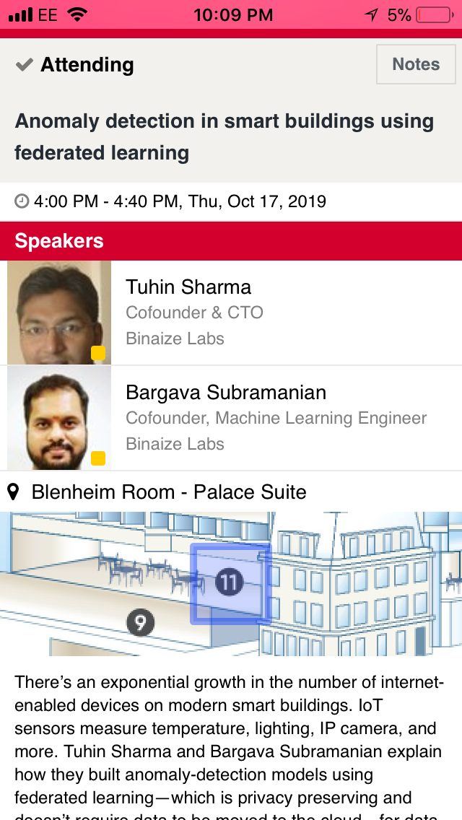
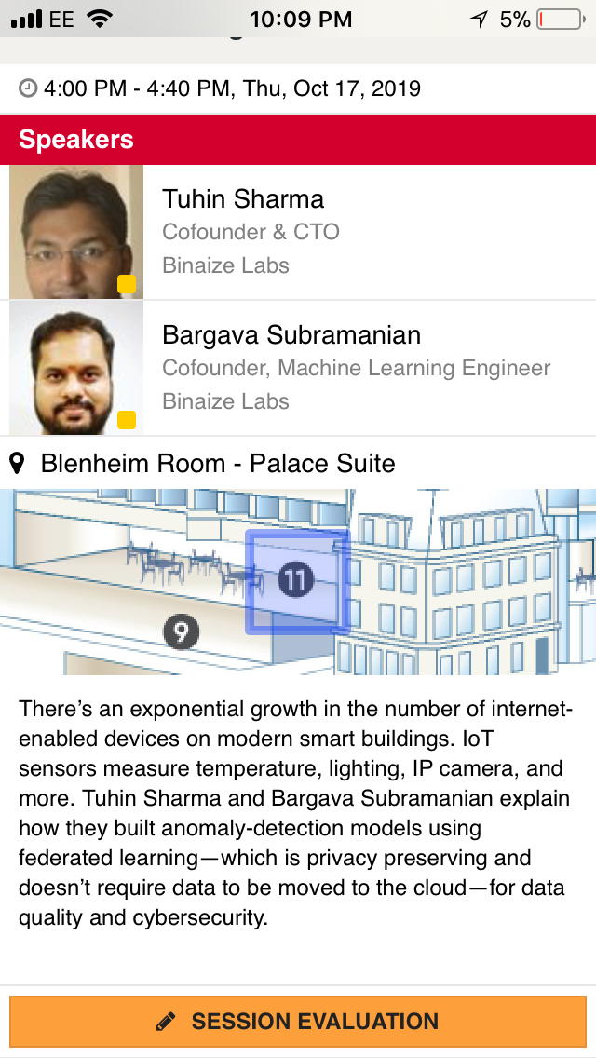
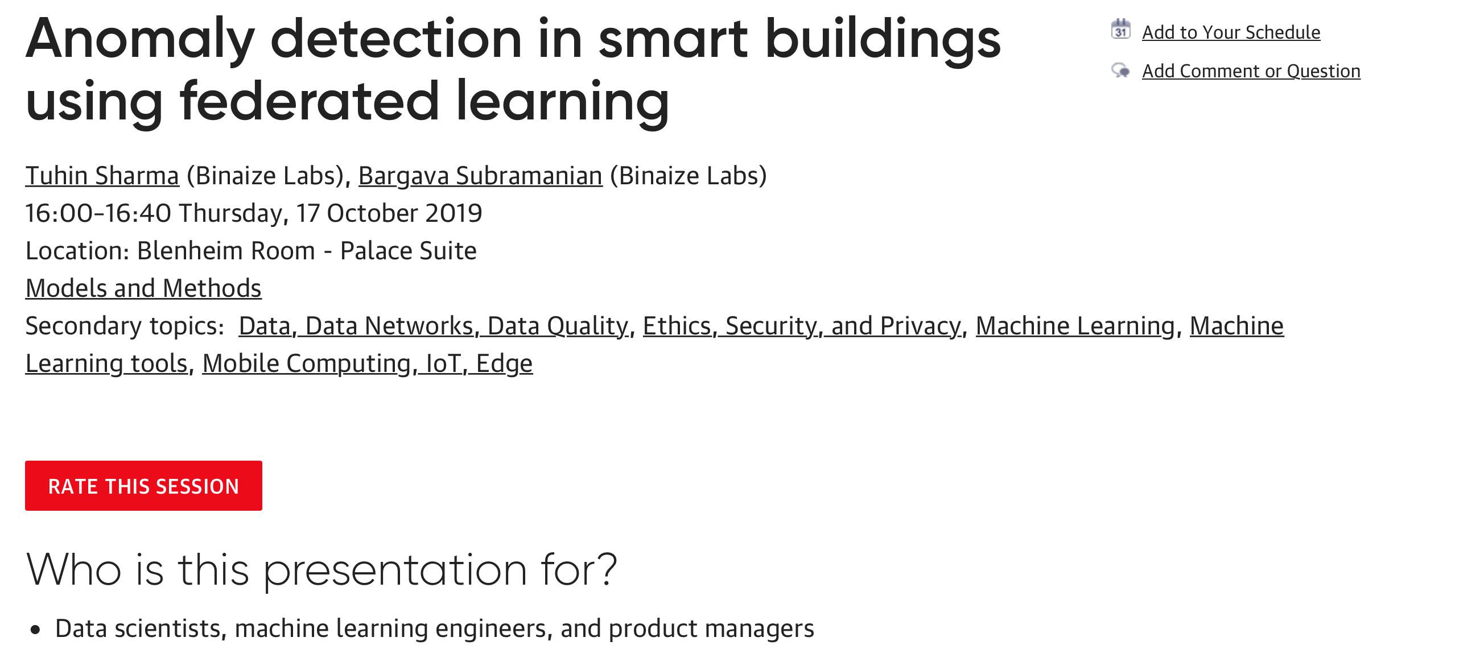
Rate today’s session
Session page on conference website
O’Reilly Events App

